Slide 1
Ethical Considerations in Software Development
Mark Burrell

Slide 2
Overview
Privacy
Security
Open Source Software
Impact

Slide 3
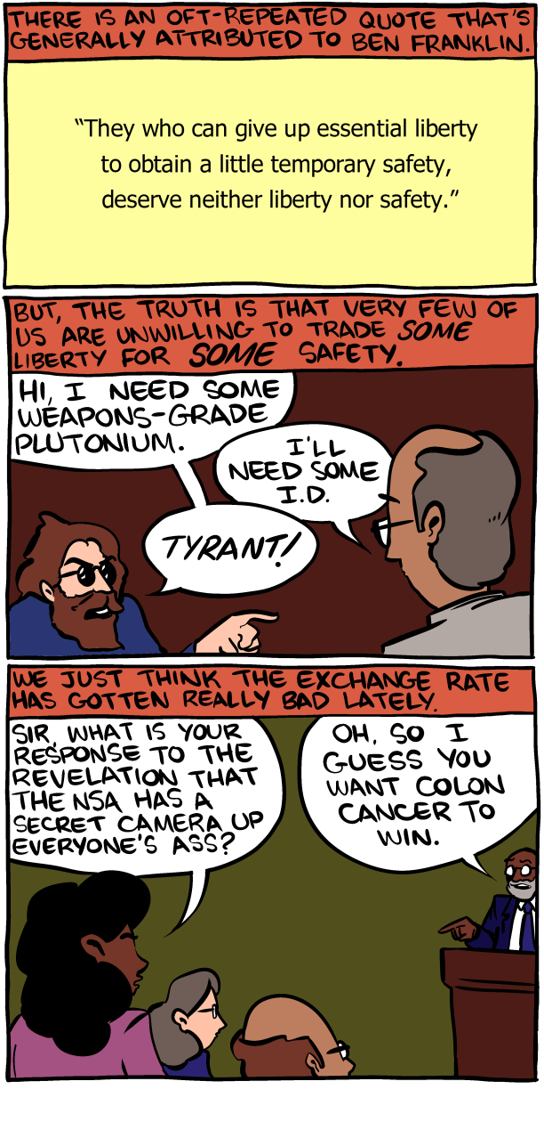
Privacy
Right to liberty/privacy
Good of the public vs good of the individual
Freeware

Slide 4
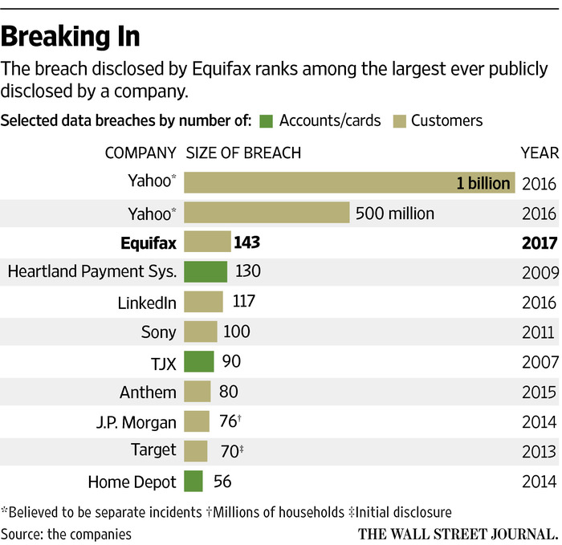
security
Data Breaches
Intentional weaknesses
Cryptography
Password guessing
  Is it ethical to use a common/easy to guess password?

Slide 5
Open vs Closed Source
Should all source code be open to the public?
  Github and other Version Control
  Linux Kernals
Should companies be allowed to copywrite/patent an algorithm?
  Differs based on country

Slide 6
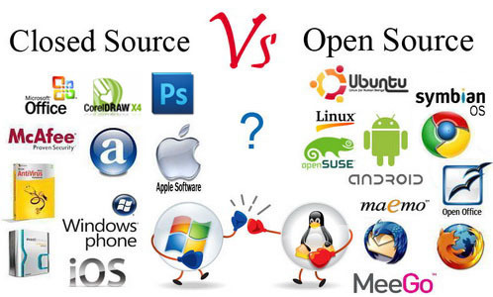
Open Source Software
Pros
Cons
Increased Innovation
Harder to hide security risks
More issues found in development vs. in release
Reduced Profit
Increased risk of exploiting security holes
Harder to prosecute for copying ideas

Slide 7
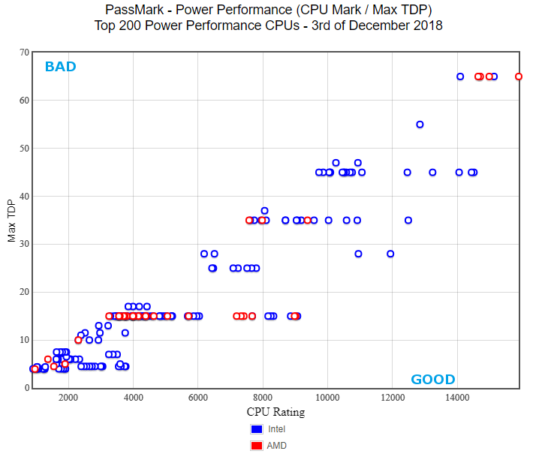
Impact of ethical considerations
Pros
Cons
Increased security
fewer scandals
Environmental impact
Lowered performance
Required development time
Datamining profit

Slide 8
Works cited
https://www.nytimes.com/2018/05/24/business/apple-samsung-patent-trial.html
https://www.smbc-comics.com/comic/2013-06-10
https://www.cpubenchmark.net/power_performance.html#id4
http://lawtomated.com/open-source-contracts-part-1/
https://www.wsj.com/articles/equifax-reports-data-breach-possibly-impacting-143-million-u-s-consumers-1504819765

